Slide 1

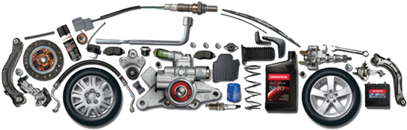
Don’t Junk it – list it
By
Raviteja Kovvada
Uday Kumar Kanchukommula
Vidyadhari Chennuri
Sai Krishna Kurra

Slide 2
About Us
Foundation Year: 2000
Core Services: Software development and IT consulting
Headquarters: Boston, MA, with a national presence
Team: Over 100 top-tier professionals
Company Ethos: Unchanged identity, independent operations
Licenses: Authorized to operate in multiple states
Clientele: Prominent automakers and parts suppliers
Notable Works: Dealer inventory systems, service appointment portals
Accolades: Renowned for exceptional service delivery
References: Provided upon request

Slide 3
Introduction
Unified Automotive Marketplace "Don't Junk It - List It" serves as a comprehensive marketplace, streamlining the sale and purchase of used car parts online.
Intuitive and Responsive Design The platform's front-end interface, built with ReactJS, offers a dynamic and responsive experience for seamless user interactions.
Structured Data Operations Using a three-tier architecture, it integrates REST APIs with an ExpressJS/Node.js backend, ensuring efficient data processing and management with MongoDB.
Robust Security Measures Security is paramount with advanced protocols like HTTPS, password hashing, input validation, and JWT authentication for safeguarding transactions and data.
Rigorous Quality Testing Our platform undergoes extensive testing, including unit, integration, UI, security, and performance tests, to ensure a high-quality and reliable system.
Adaptive Development Approach The platform is developed with the flexibility to adapt to evolving requirements and technical advancements, ensuring it meets stakeholder expectations.

Slide 4

Our Team
Kurra Sai Krishna – Project Manager
Raviteja Kovvada – Backend Developer
Uday Kumar Kanchukommula – Frontend Developer
Vidyadhari Chennuri - Lead Developer

Slide 5
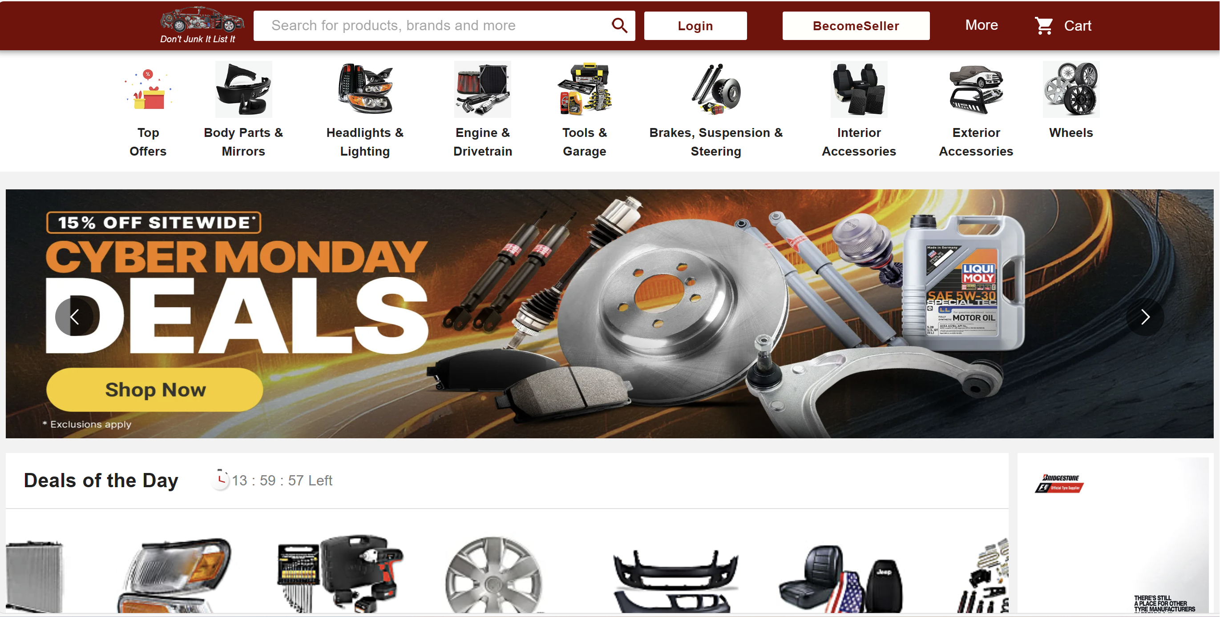
Homepage:

Slide 6
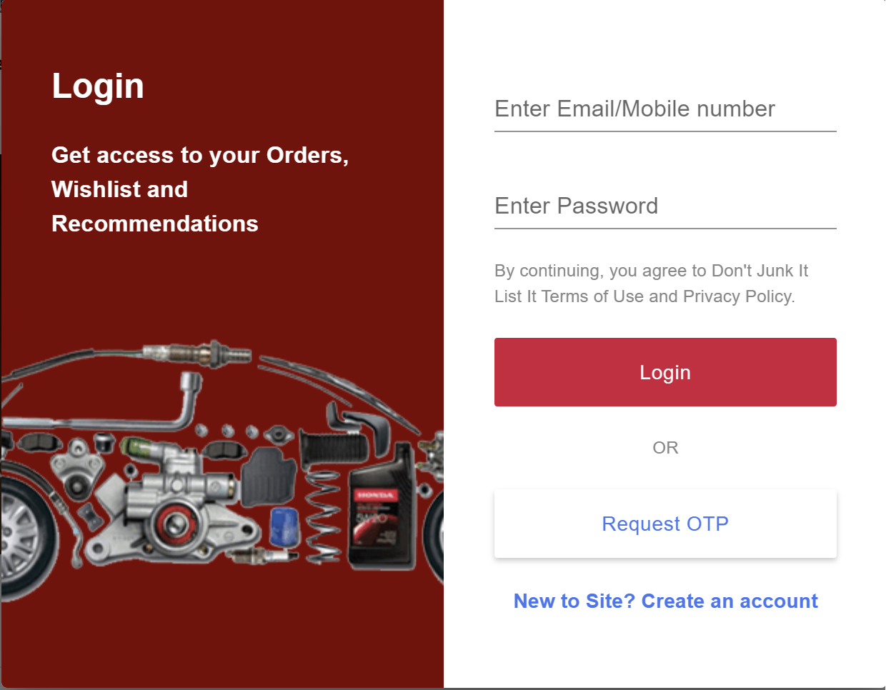
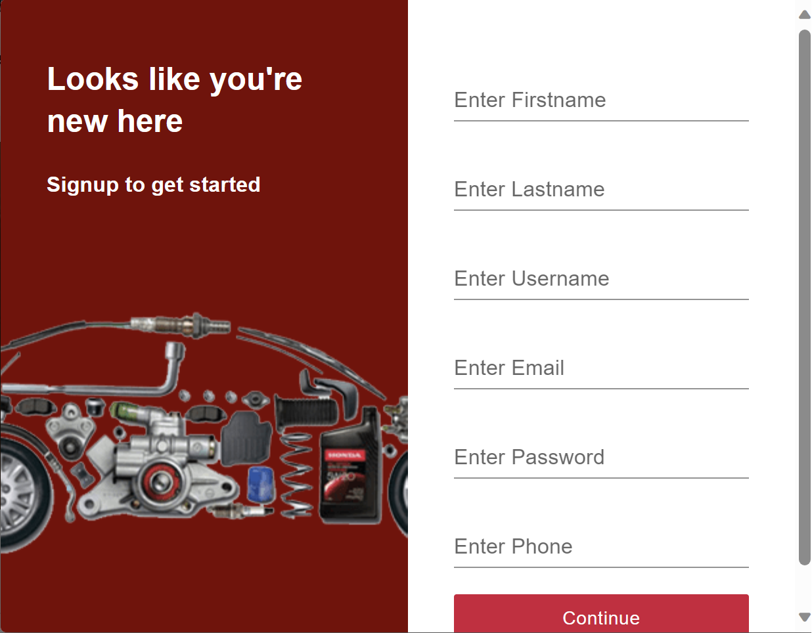
Login Page Signup Page

Slide 7
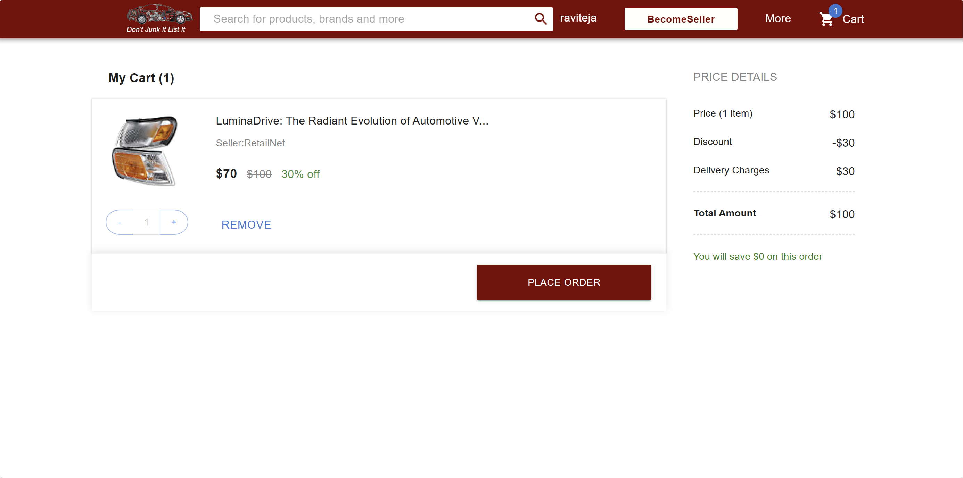
Cart

Slide 8
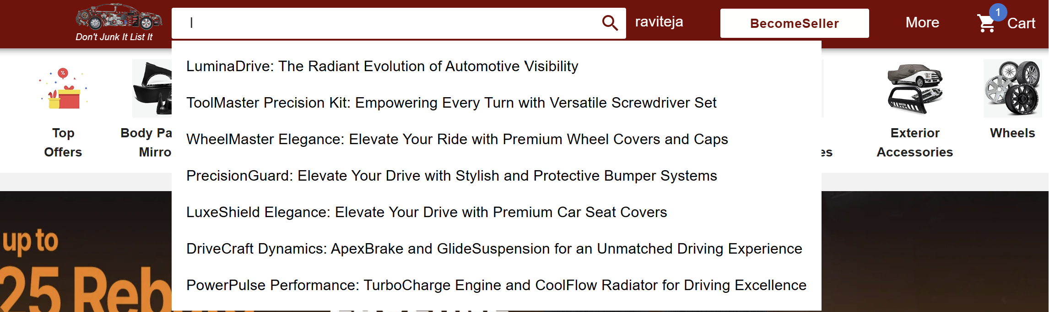
Search Functionality

Slide 9
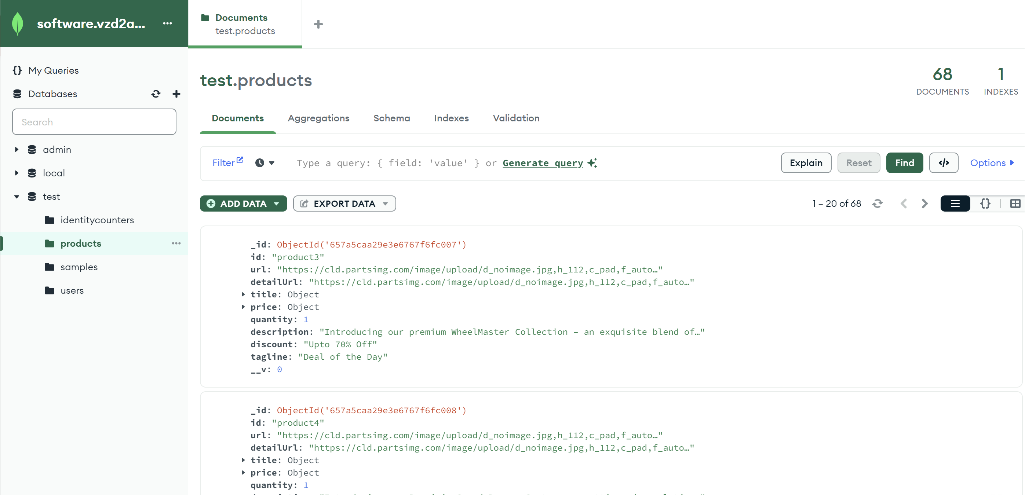
Database

Slide 10
Manual Summary
Registration and Login: Start by creating your account using our simple signup process. Once registered, log in with your credentials to access the marketplace.
Listing Items: As a seller, you can list your items for sale with ease. Our guide will take you through uploading product details, setting prices, and managing your listings.
Shopping and Cart Management: For buyers, explore the vast selection of car parts, add desired items to your cart, and proceed to checkout with our secure payment system.
Payment and Notifications: Complete your transactions with confidence. You'll receive instant notifications regarding payment confirmations and order status.
Accessibility and Responsiveness: Our platform is designed to be user-friendly across various devices and browsers, ensuring you have a consistent experience whether you're on a PC or mobile device.
Security and Permissions: Your security is our priority. This manual includes best practices for protecting your account and details on how the platform safeguards your transactions.

Slide 11

Thank You

